Slide 1

UPI FRAUD DETECTION
Muppidi Anjali (20D41A6236) Pallati Bhargavi (20D41A6238)
Kosuri Sai Kumar (20D41A6231) Gandra Akhil (20D41A6221)
Internal Guide: V Swathi

Slide 2

ABSTRACT
There is increase in UPI usage for online payments in todays digital world.
Cases of fraud associated with it are also rising.
So, it is important to detect fraudulent transactions
Few steps involving UPI transaction process using a Hidden Markov Model (HMM).
An HMM is initially trained for a cardholder.
If a UPI transaction is not accepted by the trained HMM. It is considered to be fraudulent.

Slide 3
INTRODUCTION
A Method for finding valuable patterns in databases that grow over time.
We used a special kind of list for storing data, which means they don't have to guess at possible patterns, and they only need to look at the database once.
This method sorts the data based on how valuable each item is, making a list for each item from least to most valuable.
When new data is added, they update the lists without having to redo the old data.
Adjust the sorting to include the new data and then look for valuable patterns based on a user-set minimum value.

Slide 4
EXISTING SYSTEM
To detect counterfeit transactions, three machine-learning algorithms were presented and implemented.
There are many measures used to evaluate the performance of classifiers or predictors, such as the Gradient Boost Classifier, Vector Machine, Random Forest, and Decision Tree.
These metrics are either prevalence dependent or prevalence-independent.
Furthermore, these techniques are used in UPI fraud detection mechanisms, and the results of these algorithms have been compared.

Slide 5

EXISTING SYSTEM DIS-ADVANTAGES
Inaccurate prediction : Takes more time due to large amount of data
Expensive: Implementation and maintenance
Lack of human intelligence: It wasn’t able to coupe up with advance technologies
Privacy Concerns: Extensive monitoring for fraud detection can raise privacy worries among users.

Slide 6

PROPOSED SYSTEM
In this system, the transaction pattern dataset was taken as input.
The input data was taken from the dataset repository. Then, we have to implement the data pre-processing step.
Then, we have to split the dataset into test and train. The data is splitting is based on ratio. Amount of train data is more than amount of test data. Training portion is used to evaluate the model and testing portion is used to predicting the model.
The machine learning algorithms such as Random Forest ,AdaBoost and Support Vector Machine are implemented in the next step.
Finally, the experimental results shows that the performance metrics such as accuracy and comparison.
.

Slide 7
ADVANTAGES
Improved Security: UPI fraud detection uses advanced algorithms to enhance transaction safety.
Early Alerts: Real-time detection notifies users and institutions promptly, preventing fraud.
Minimized Losses: Swift action reduces financial losses for users and institutions alike.
Trust Building: Effective fraud prevention fosters trust, encouraging more users to embrace digital payments.

Slide 8
MODULES DESCRIPTION:
Data Selection and Loading: Select the appropriate data to train the machine.
Data Preprocessing: The given data is preprocessed by system to train the system and tio test the system
Splitting Dataset into Train and Test Data: The preprocessed data is splitted majorly into train data and some of the data into test data.
Classification: Identifying to which set of categories, a new observation belongs to, on the basis of a training set of data containing observations and whose categories membership is known.
Prediction: Predictive analytics algorithms try to achieve the lowest error possible by either using “boosting” or “bagging”.
Result Generation: The Final Result will get generated based on the overall classification and prediction.

Slide 9
FLOW DIAGRAM
Input data
Preprocessing
Handling missing values
Label Encoding
Test
Data Splitting
Train
Random Forest
Classification
Ada Boost
Performance Analysis
Accuracy
SVM
Precision
Performance Analysis
Sensitivity
Recall

Slide 10
SYSTEM ARCHITECTURE
Train set
Dataset
Pre-processed data
Feature Selection
Test set
Prediction
Classification

Slide 11
USE CASE DIAGRAM
Start
Select Dataset
Detection System
Feature Selection
Cleaning Dataset
Data Splitting
Classification
User
Prediction

Slide 12
SYSTEM REQUIREMENTS
SOFTWARE REQUIREMENTS:
O/S : Windows 7.
Language :Python
Front End :Anaconda Navigator – Spyder
HARDWARE REQUIREMENTS:
System : Pentium IV 2.4 GHz
Hard Disk : 200 GB
RAM :4GB

Slide 13
Sample Source Code:
print()
print("Ada Boost Accuracy is:",Result_3,'%')
print()
print("Confusion Matrix:")
from sklearn.metrics import confusion_matrix
cm1=confusion_matrix(y_test, AD_prediction)
print(cm1)
print("-------------------------------------------------------")
print()
import matplotlib.pyplot as plt
import seaborn as sns
sns.heatmap(cm1, annot = True, cmap ='plasma',
linecolor ='black', linewidths = 1)
plt.show()
from sklearn.ensemble import AdaBoostClassifier
abc = AdaBoostClassifier(n_estimators=10,
learning_rate=20)
abc.fit(x_train, y_train)
AD_prediction=abc.predict(x_test)
print()
print("---------------------------------------------------------------------")
print("Ada Boost Algorithm ")
print()
Result_3=accuracy_score(y_test, AD_prediction)*100
print(metrics.classification_report(y_test,AD_prediction))

Slide 14
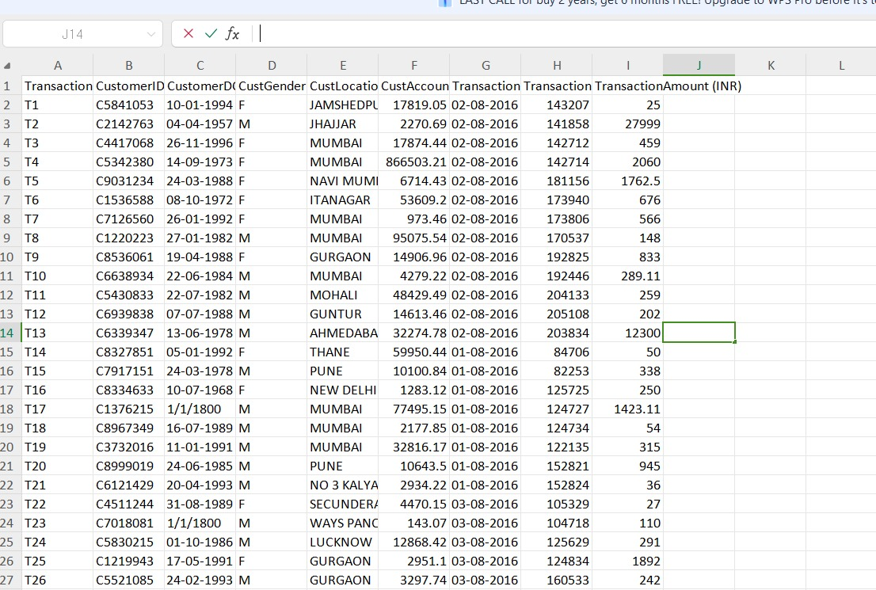
INPUT :
Input Data Set

Slide 15
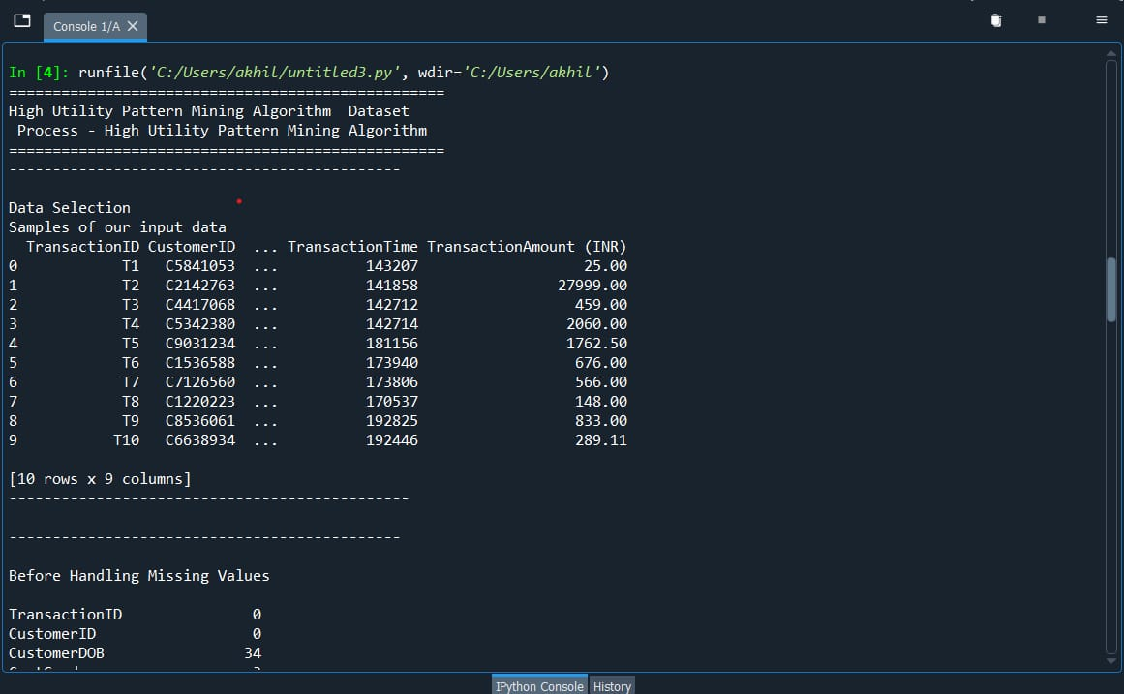
OUTPUT :
Output of Data Set Selected

Slide 16
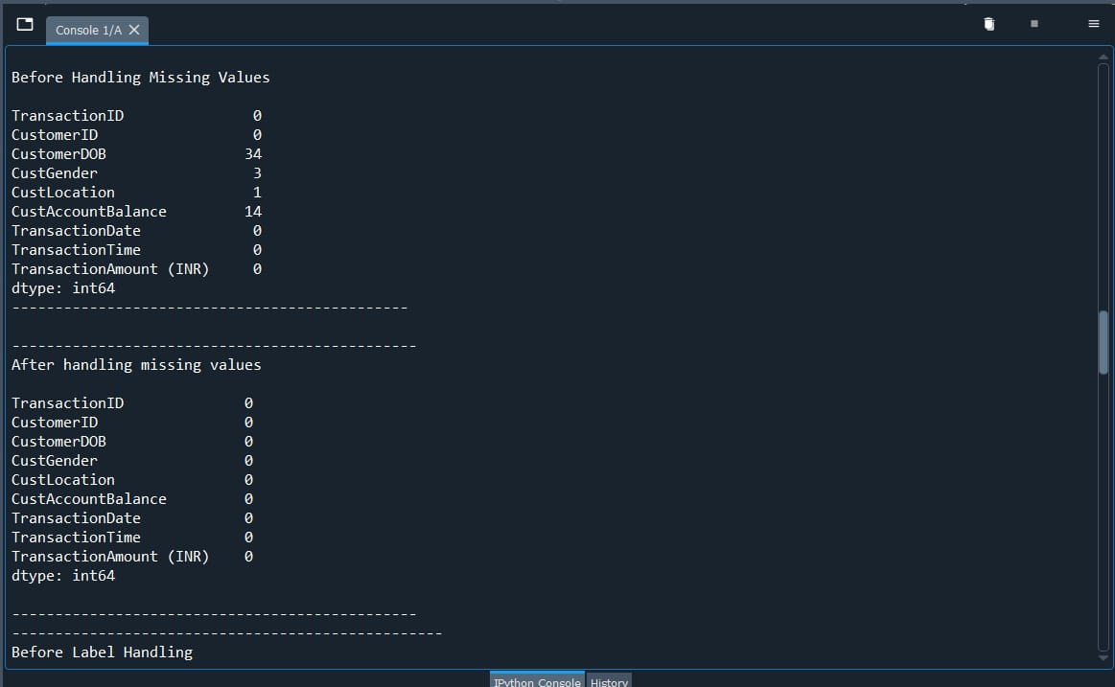
Handling the missing values in the Data Set

Slide 17
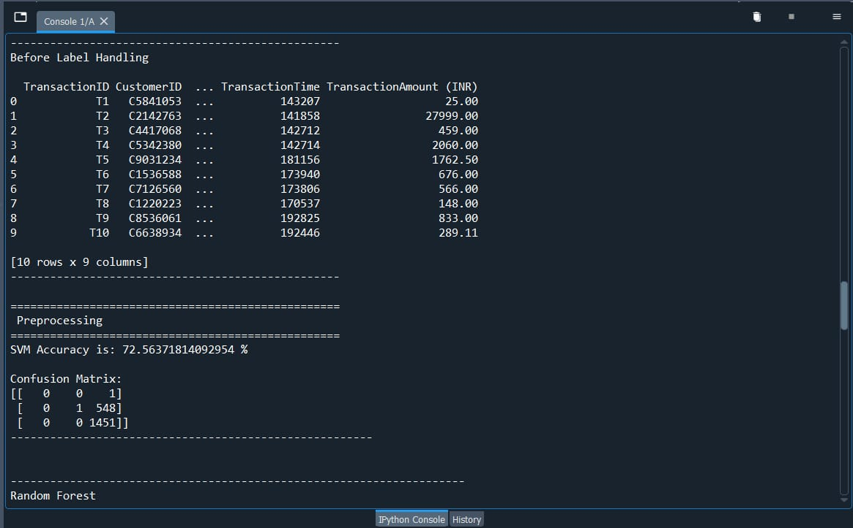
Accuracy of SVM Algorithm

Slide 18
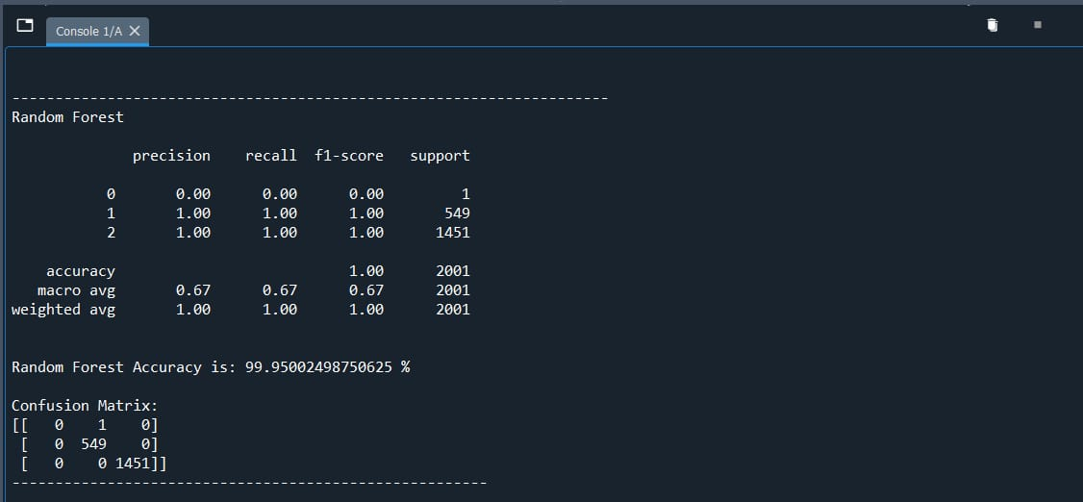
Accuracy of Random Forest Algorithm

Slide 19
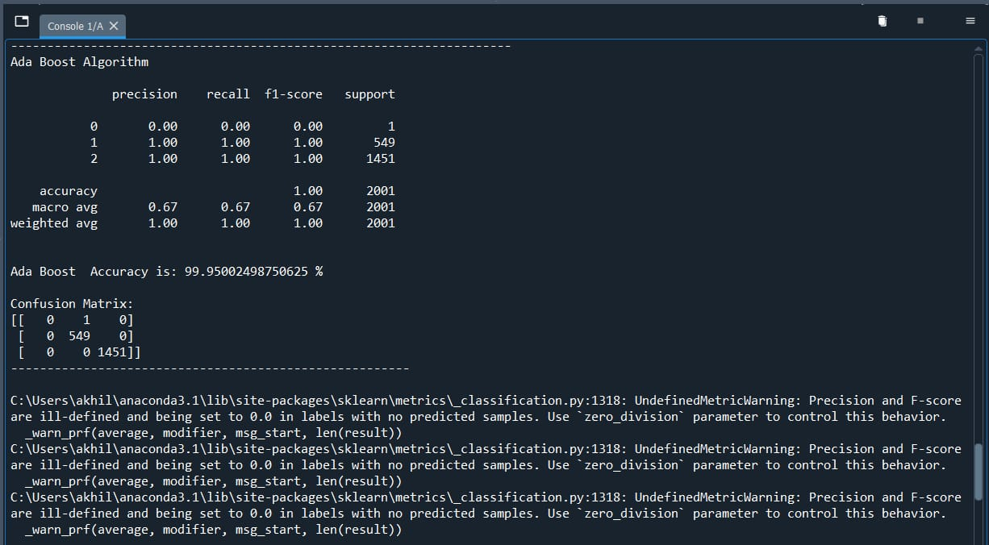
Accuracy of Ada Boost Algorithm

Slide 20
CONCLUSION:
In this study, we endeavored to construct a robust fraud detection system for Unified Payments Interface (UPI) transactions using Random Forest (RF), AdaBoost, and Support Vector Machine (SVM) algorithms. Our objective was to develop a model capable of accurately identifying fraudulent activities while minimizing false positives.
In conclusion, our study underscores the potential of RF, AdaBoost, and SVM algorithms in mitigating fraud risks within the UPI ecosystem.

Slide 21


